Slide 2
Getting started with Git and GitHub
Introduction to source control
Introduction to Git and Github
Setting up Git
Creating a repository
Cloning a repository
Adding files to a repository
Committing changes
Pushing changes to Github
Pulling changes from Github
Branching and merging

Slide 3
Source Control
Keep track of changes made to code
Work collaboratively on code with others
Roll back changes if necessary
Test new features without affecting the main codebase
Ensure that everyone is working on the same version of code

Slide 4
git
Git is a distributed version control system that tracks changes in any set of computer files.
It was originally developed in 2005 by Linus Torvalds, the creator of the Linux operating system kernel.
A staggering number of software projects rely on Git for version control, including commercial projects as well as open source.
CLI tool

Slide 5
Github.com
GitHub is a web-based platform that uses Git for version control.
It was launched in 2008 and has since become one of the largest code hosting platforms in the world.
GitHub allows developers to collaborate on projects, track changes to code, and host their code repositories online.

Slide 6
Exploring Github

Slide 7
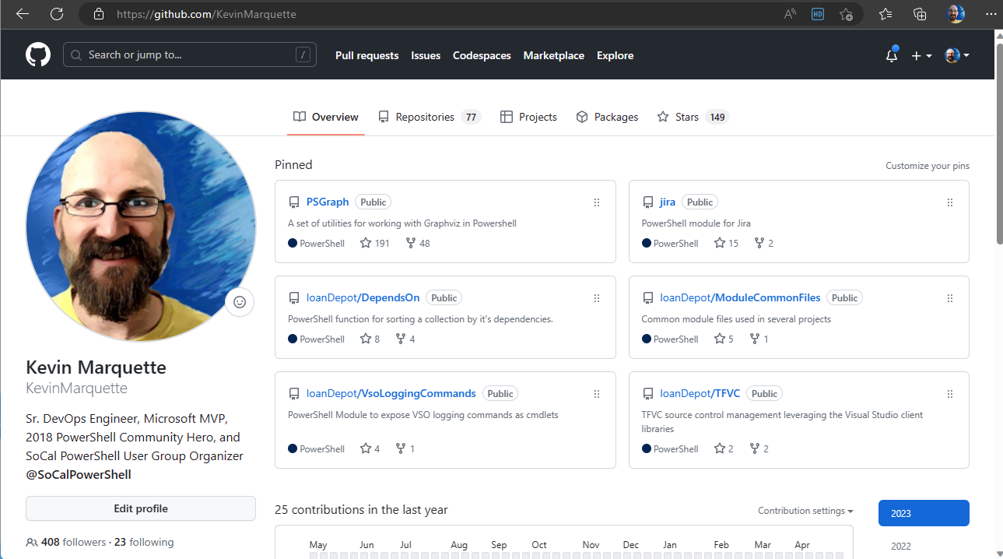

Slide 8
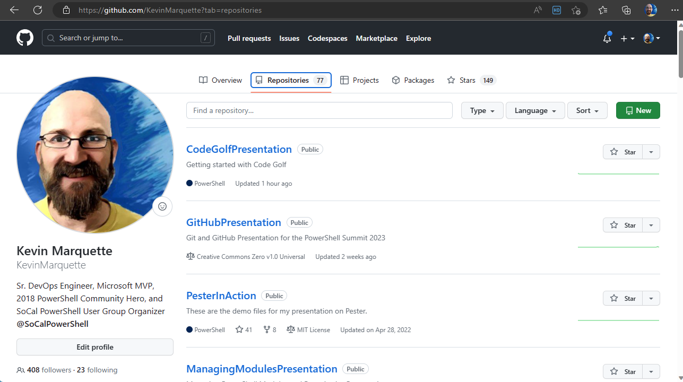

Slide 9
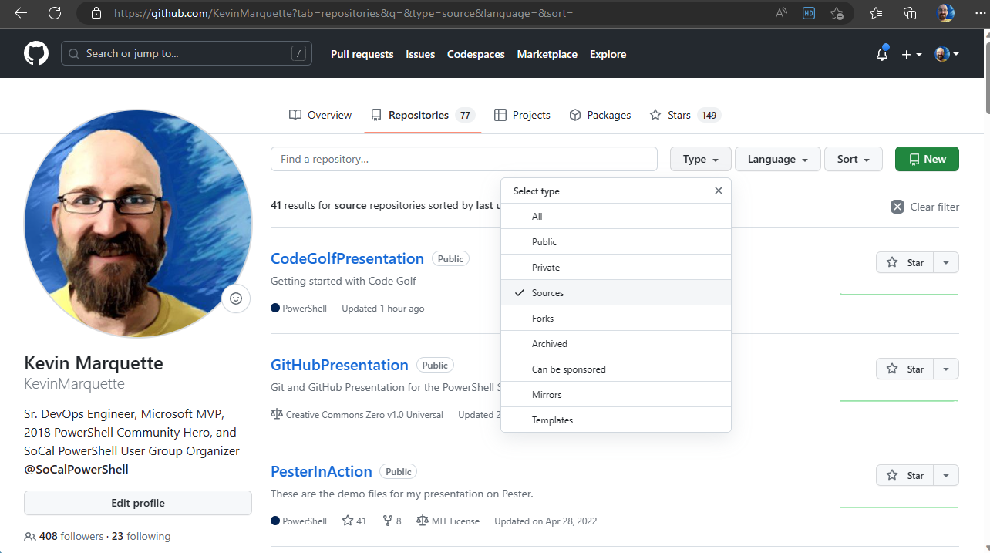

Slide 10
Github: clone
Downloading remote repository files

Slide 11
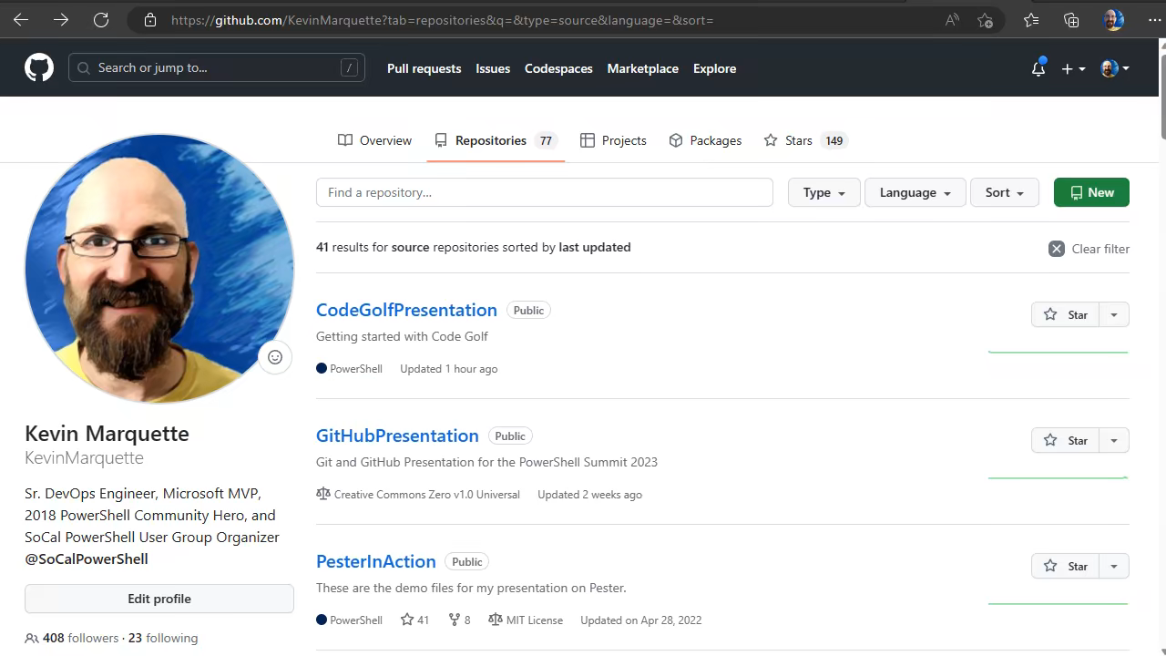

Slide 12
Github: Commit
Making and viewing changes

Slide 13
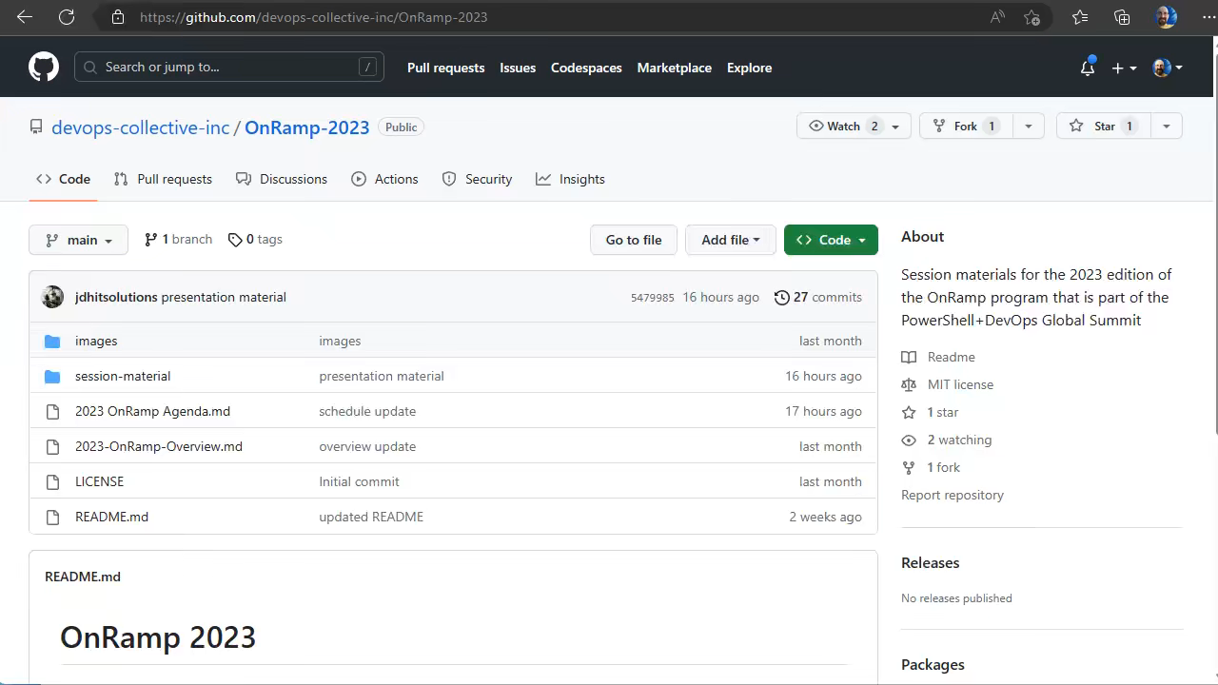

Slide 14
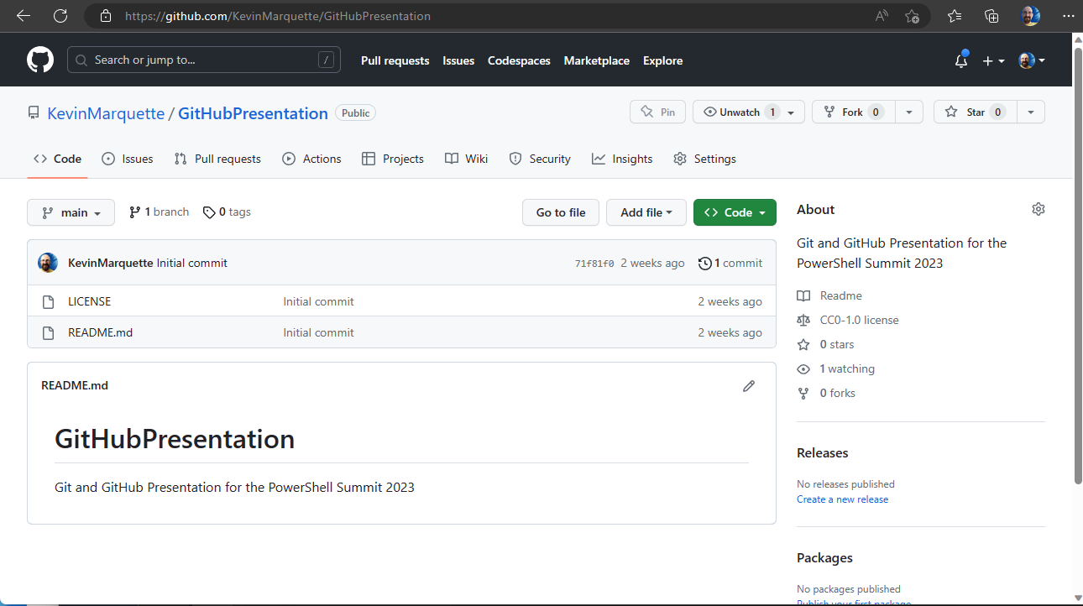

Slide 15
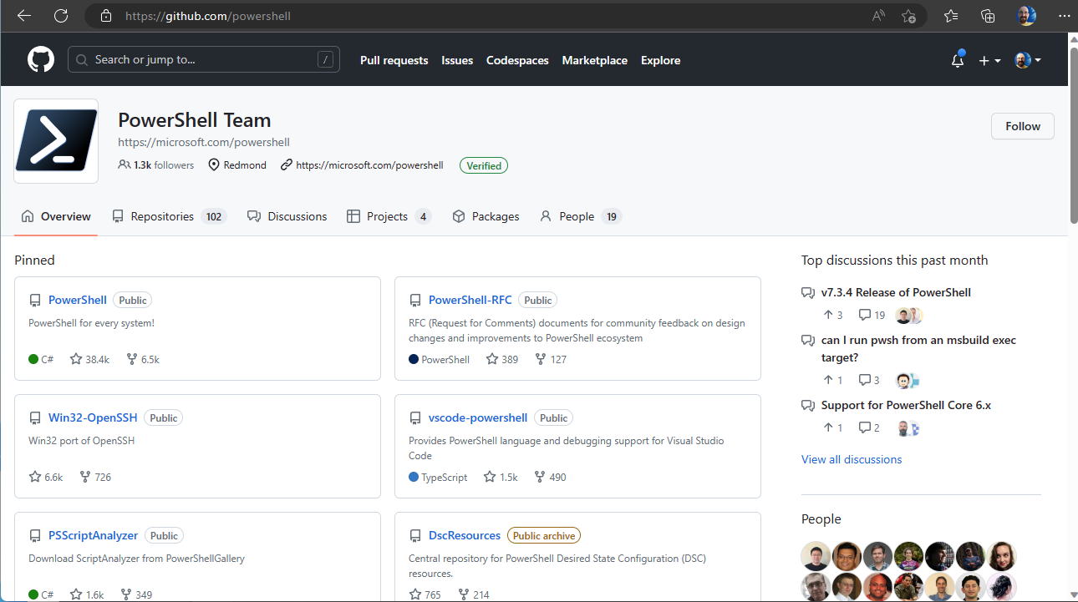

Slide 16
Installing Git
Installing git

Slide 17
Create and Clone Repo

Slide 18
